Slide 1
Homelessness in British Columbia
By Nick Falvo, PhD
Director of Research and Data
Calgary Homeless Foundation
October 11, 2017

Slide 2
Overview
Contributors to homelessness
Federal and BC policy contexts over past decades
Recent developments federal and at provincial level in BC
‘Take away’ messages.

Slide 3
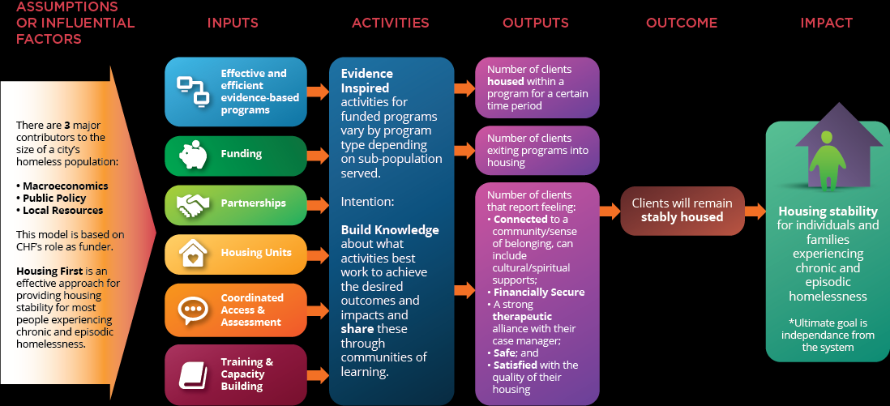

Slide 4
Three major contributors to the size of a city’s homeless pop.
Macroeconomics
e.g., price of oil, performance of US economy, international financial crisis
Local officials have little control over these, but understanding their impact on homelessness is important

Slide 5
Three major contributors to the size of a city’s homeless pop. (cont’d)
2. Public policy
e.g., budgetary commitments to housing & homelessness, social assistance benefit levels.
Local officials don’t determine these, but they can advocate for changes.

Slide 6
Three major contributors to the size of a city’s homeless pop. (cont’d)
3. Local resources
e.g., which subgroups get targeted for supportive housing; what % of local resources go to supportive housing vs. shelters; management of contracts with local non-profits
Local officials may have a considerable amount of influence on all of the above (though this depends on province/territory).

Slide 7
Let’s briefly consider the case of Calgary…

Slide 8
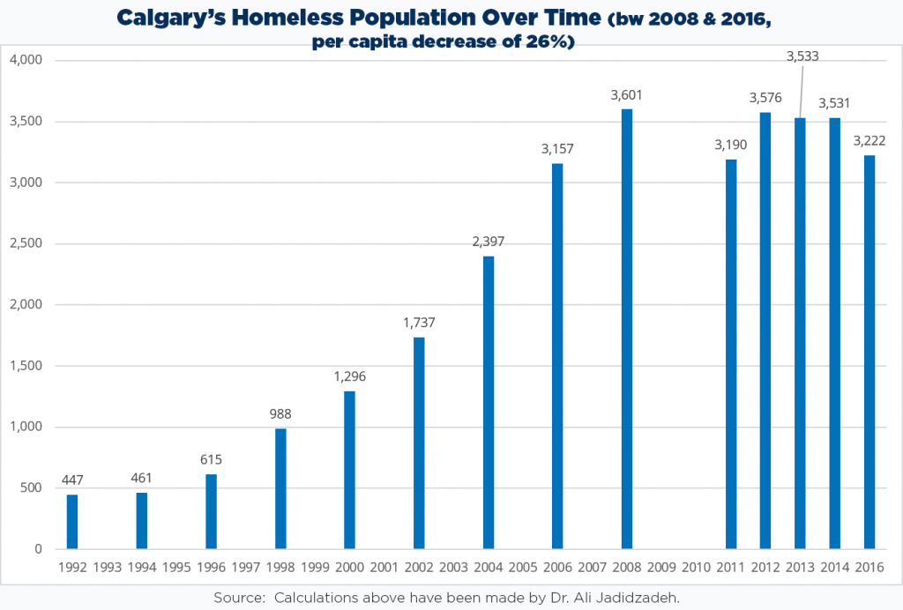

Slide 9
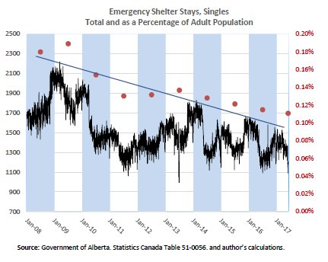
Notes:
Source: School of Public Policy (University of Calgary).
Retrieved from: https://www.policyschool.ca/wp-content/uploads/2017/09/Social-Trends-Shelters-September-2017.pdf

Slide 10
Why the decline in homelessness?
1. Macroeconomics
  Price of oil decreased
  This led to much out-migration by workers.
  This led to a higher vacancy rate.
  This made Calgary landlords more eager to rent units.

Slide 11
Why the decline in homelessness (cont’d)?
2. Public policy
  Benefit levels for soc. assistance recipients have increased since 2008.
  This has likely make it easier for marginally-housed people to hang on to their housing, and it has likely made it easier for persons experiencing homelessness to access the private rental market.
Notes:
Notes: Total annual income received by a ‘single employable’ household receiving social assistance jumped by more than 30% in 2009; and total annual income for a single adult receiving Assured Income for the Severely Handicapped increased by 30% between 2011 and 2013.

Slide 12
Why the decline in homelessness (cont’d)?
3. Local resources
  Since 2008, progress has been made at the community level in YYC.
  This relates to how we triage, how we monitor performance of local non-profits, and what we decide to fund and not fund each year.

Slide 13
Key ‘take away’ from Calgary’s experience
Don’t attribute rise and fall in homelessness to one factor.
Rather, think of fluctuations in a three-pronged way.

Slide 14
Let’s talk about the federal situation over the past several decades…

Slide 15
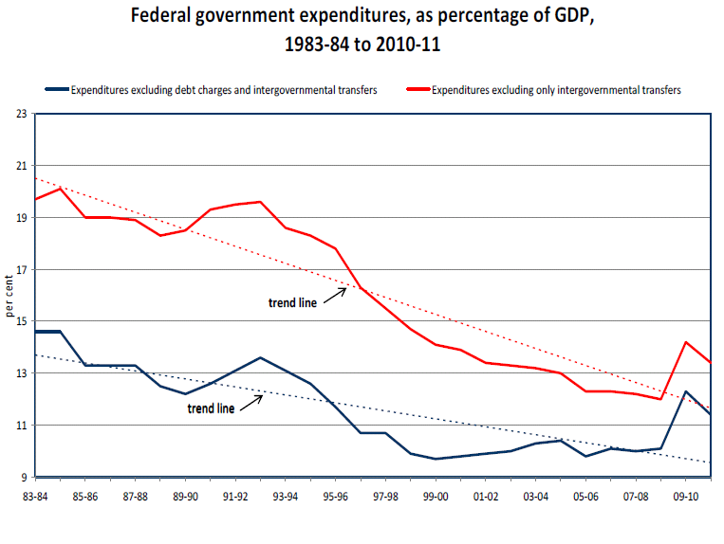
Notes:
Source: Mendelson, M. (2012). Is Canada (still) a fiscal union? Retrieved from Caledon Institute of Social Policy website: www.caledoninst.org/Publications/PDF/998ENG.pdf.
Note: The above image has been copied and pasted directly from page 2 of the report.

Slide 16
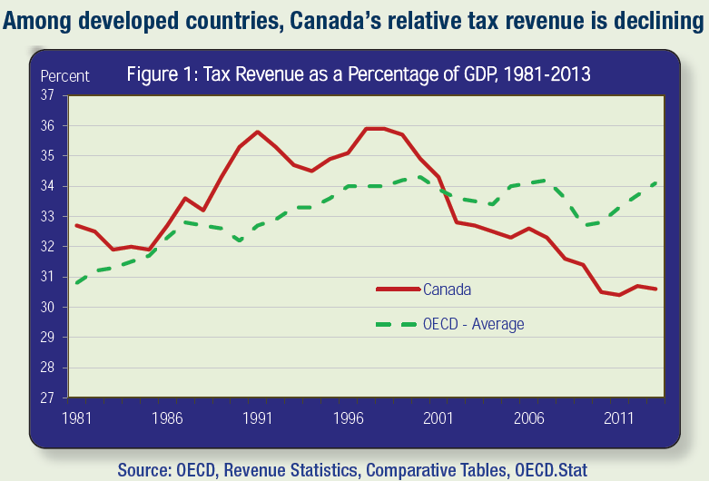
Notes:
Source: Citizens for Public Justice. (2015). Taxes for the common good: A public justice primer on taxation (Fact Sheet Series). Retrieved from Citizens for Public Justice website: http://www.cpj.ca/sites/default/files/docs/files/Taxes-for-the-Common-Good-FINAL.pdf
Note: “The data in the graph is OECD total revenue: it includes all levels of government” (M. Veall, personal communication, September 15, 2015).

Slide 17
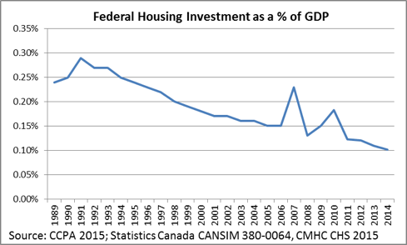
Notes:
Source: Wellesley Institute. (2015, September 22). Access to housing – HEIA in the federal election. Retrieved from http://www.wellesleyinstitute.com/housing/access-to-housing-heia-in-the-federal-election/

Slide 18
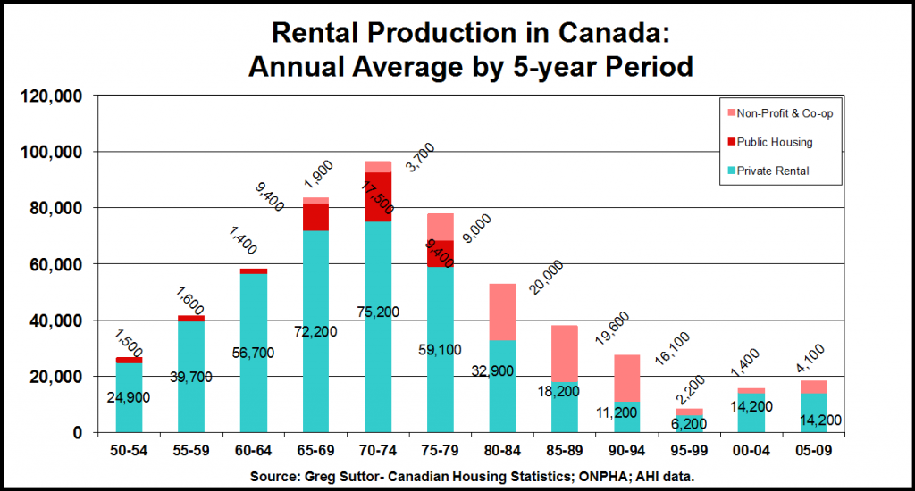

Slide 19
Let’s talk about the situation in BC over the past several decades…

Slide 20
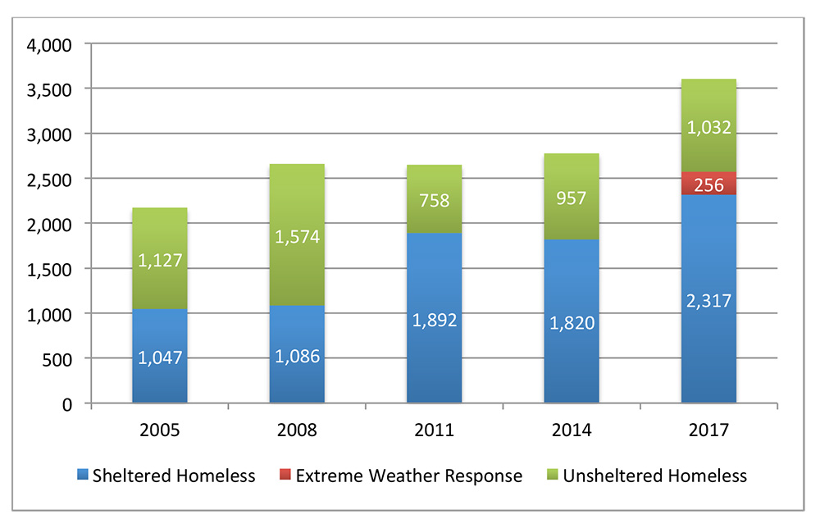
Rising homelessness in Vancouver
Notes:
Read more: http://www.metrovancouver.org/services/regional-planning/homelessness/resources/Pages/default.aspx

Slide 21
Notes:
Source: Suttor., G. (2016). Still renovating: A history of Canadian social housing policy. Montreal: McGill-Queen’s University Press.
Note: This is a modified version of Figure 7.1 from the book.

Slide 22
Social assistance reforms
Some brought in 1996; others in 2002 and 2003.
Lower benefit levels
A reduction in asset exemption limits
Stricter eligibility requirements
Proof of job search required
Cheque line ups (as opposed to mail)
More fraud detection
However, progressive reforms brought in in 2012.
Notes:
Source: Kneebone and White (2009). Retrieved from: https://muse.jhu.edu/article/263110/pdf (see p. 28).
Notes: Reforms brought in in April 2002 are discussed here: http://www.policyalternatives.ca/sites/default/files/uploads/publications/BC_Office_Pubs/bc_2006/denied_assistance.pdf
Notes: Progressive reforms brought in in 2012 discussed here: http://www.policynote.ca/new-bc-welfare-rules-some-positive-steps-forward-and-couple-steps-back/

Slide 23
Notes:
Source: Tweddle, A., Battle, K., & Torjman, S. (2016). Canada social report: Welfare in Canada, 2015. Retrieved from http://www.canadasocialreport.ca/WelfareInCanada/2015.pdf

Slide 24
Notes:
Notes: Increase in social assistance benefit levels in 2005 is associated with improved food security for recipients. Read more here: http://www.sciencedirect.com/science/article/pii/S0091743516303048

Slide 25
Notes:
Notes: A recent report looking at HF in Vancouver found that, while Housing First works as a social work intervention, lack of affordable housing, landlord discrimination and inadequate income assistance all constrain it in the Metro Vancouver Region.

Slide 26
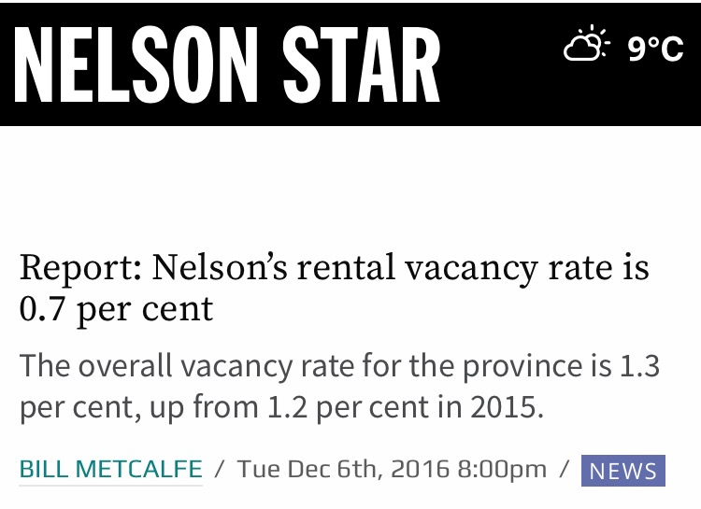
Notes:
Full article: http://www.nelsonstar.com/news/report-nelsons-rental-vacancy-rate-is-0-7-per-cent/. The report itself can be found here: https://www.cmhc-schl.gc.ca/odpub/esub/64487/64487_2016_A01.pdf

Slide 27
Recent federal developments
2017 federal budget was most important federal budget for housing since 1993.
It promised a lot of housing and homelessness funding…but over an 11-year horizon.

Slide 28
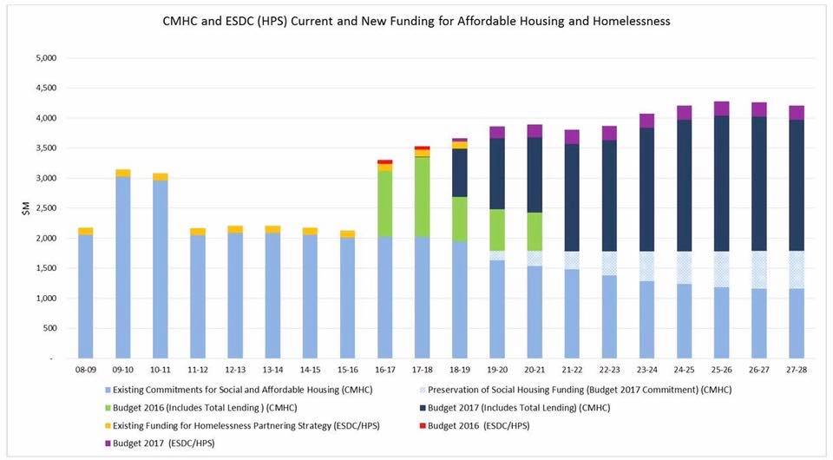
Notes:
Taken from: http://calgaryhomeless.com/info/research-blog/ten-things-know-2017-federal-budget/

Slide 29
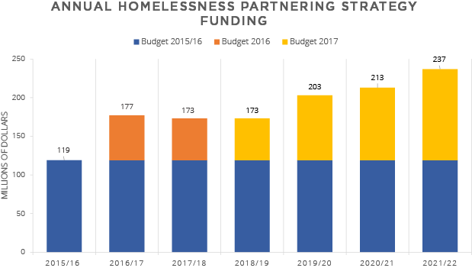
Notes:
Taken from: http://calgaryhomeless.com/info/research-blog/ten-things-know-2017-federal-budget/

Slide 30
Recent federal developments (cont’d)
Lots of recent talk federally re: a national housing benefit.
This likely won’t see the light of day for another three years (so no immediate impact on the ground).
The rumour is that savings from expiring operating agreements for social housing will be reinvested into this type of benefit.

Slide 31
Recent Developments in BC
New tax bracket created for ppl who earn more than $150K/yr.
Increase in corporate tax rate.
$100/month increase in social assistance (effective Oct. 2017).
Promise of housing strategy, w some housing & homelessness funding already committed (including funding for modular units).
Notes:
Read more: http://www.policynote.ca/budget-update-investments-a-positive-first-step-for-british-columbians/ and https://www.nelsonstar.com/news/ndp-funds-2000-housing-units-for-homeless/

Slide 32

Recent Developments in BC (cont’d)
Notes:
Read more: http://vancouversun.com/news/politics/ndp-government-vows-to-boost-housing-affordability-but-no-renters-rebate and https://beta.theglobeandmail.com/news/british-columbia/bc-ndps-promised-renters-rebate-absent-from-first-budget/article36234521/?ref=http://www.theglobeandmail.com&

Slide 33
Recent Developments in BC (cont’d)
Budget includes $291M over two years to build 2,000 modular housing units for homeless people, along w $172M to operate them (with 24/7 support).
Another $208M for construction of 1,700 new rental units to be operated by non-profit organizations.
Notes:
Read more: https://www.nelsonstar.com/news/ndp-funds-2000-housing-units-for-homeless/ and http://bcnpha.ca/news/globe-and-mail-bc-ndps-promised-renters-rebate-absent-from-first-budget/ and http://bcnpha.ca/news/times-colonist-housing-for-homeless-among-social-commitments-from-ndp/ + http://www.policynote.ca/budget-update-investments-a-positive-first-step-for-british-columbians/?utm_source=feedburner&utm_medium=feed&utm_campaign=Feed%3A+CcpaPolicyNote+%28CCPA+Policy+Note%29

Slide 34
‘Take home’ messages
Try to take a three-pronged view of homelessness; a lot of factors determine numbers.
Good things happening at both federal & provincial level in BC.
Watch for interaction of national housing benefit with provincial programs (including a provincial renters’ rebate).

Slide 35
Acknowledgement
I wish to thank Ann Harvey for assistance with this presentation.
I also wish to thank my colleague, Chidom Otogwu.

Slide 36
Thank You
Author contact info:
Nick Falvo
nick@calgaryhomeless.com

